Slide 1
Chapter 7
Choosing Innovation Projects

Slide 2
TEACHING OBJECTIVES
1. Familiarize students with the wide variety of methods available (both quantitative and qualitative) to evaluate innovation projects.
2. Highlight the important role played by managerial assumptions in the accuracy and utility of any measure used.
3. Emphasize the importance of a balanced R&D project portfolio (i.e. advanced R&D, breakthrough, platform, and derivative).

Slide 3
Overview
Methods of choosing innovation projects range from informal to highly structured, and from entirely qualitative to strictly quantitative.
Often firms use a combination of method to more completely evaluate the potential (and risk) of an innovation project.
Notes:
3

Slide 4
The Development Budget
Most firms face serious constraints in capital and other resources they can invest in projects.
Firms thus often use capital rationing: they set a fixed R&D budget and uses a rank ordering of possible projects to determine which will be funded.
R&D budget is often a percentage of previous year’s sales.
Percentage is typically determined through industry benchmarking, or historical benchmarking of firm’s performance.
Notes:
4

Slide 5
The Development Budget Continued
Industry | R&D as a Percent of Sales
Software & Internet | 13.3%
Health | 13.3
Computing & Electronics | 7.0
Aerospace & Defense | 4.8
Automotive | 3.8
Industrials | 2.2
Consumer Products | 2.0
Telecom | 1.4
Chemicals & Energy | 1.0
R&D Intensity varies considerably across and within industries.
Notes:
5

Slide 6
Theory In Action
Financing New Technology Ventures
Large firms can fund innovation internally; new start-ups must often obtain external financing.
In first stages of start-up and growth, entrepreneurs may have to rely on family, friends, and credit cards.
Start-ups might be able to obtain some funding from government grants and loans.
If idea and management are especially promising, entrepreneur may secure funds from “angel investors” (typically seed stage and <$1 million) or venture capitalists (multiple early stages, >$1 million).
Notes:
6

Slide 7
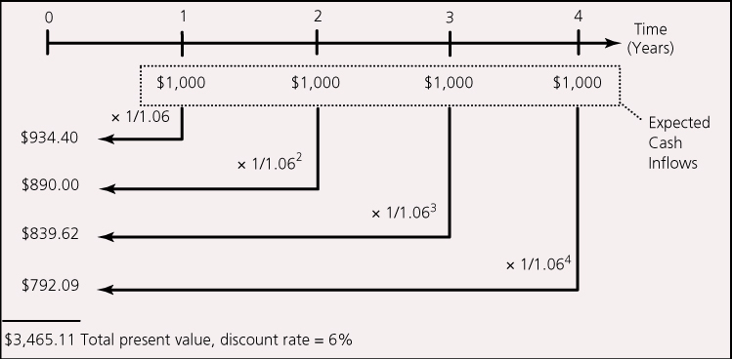
Quantitative Methods for Choosing Projects
Commonly used quantitative methods include discounted cash flow methods and real options.
Discounted Cash Flow (DCF)
Net Present Value (NPV): Expected cash inflows are discounted and compared to outlays.
Notes:
7

Slide 8
Time Value of Money
The appreciation of money over time is called the time value of money.
$1000 $1100 (discount rate=10%, one year)
The monetary value of the same amount at different times is not equal, so it is not suitable to directly compare the monetary value at different times. They need to be converted to the same time point.

Slide 9
Calculation of Time Value of Money
Simple Interest
(1) Calculation of Sigle Rate
I=P×i×n
P: principal, or present value
i: interest rate
n: number of periods
I: interest
(2) Calculation of Sum of Principal and Interest
F: future value, or sum of principal and interest
F=P+P×i×n=P(1+i×n)

Slide 10
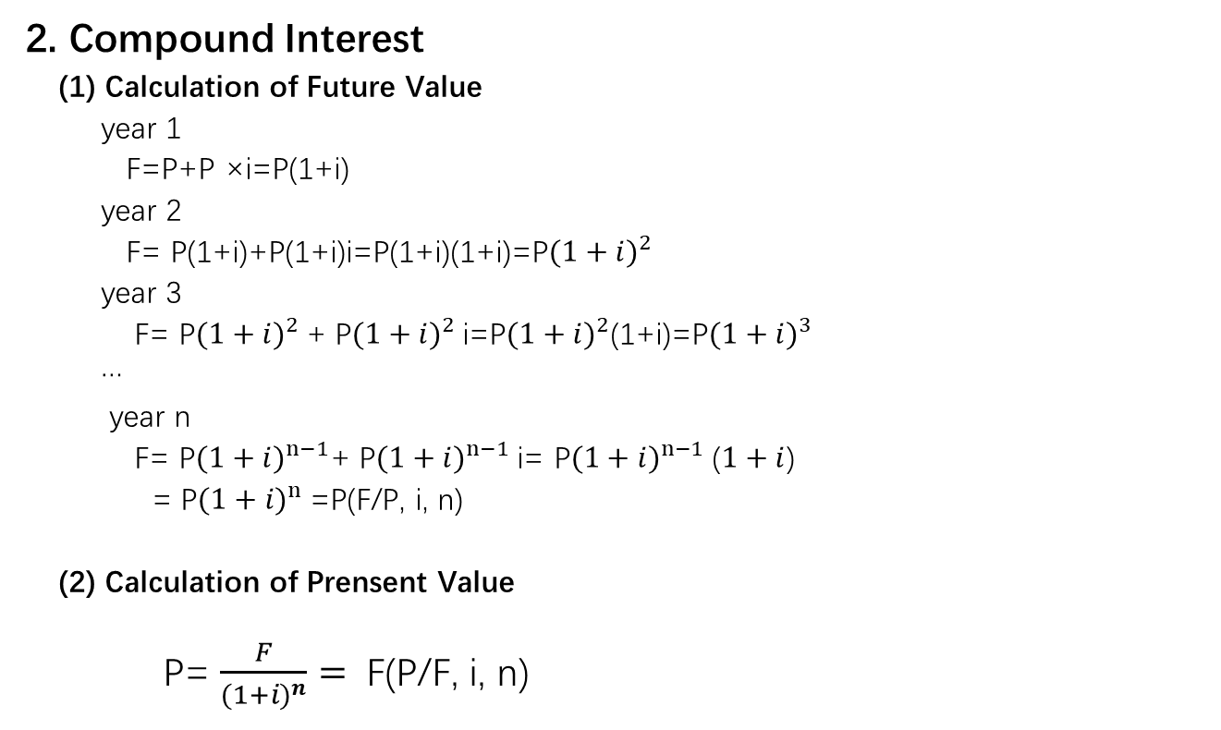
2. Compound Interest
(1) Calculation of Future Value
year 1
F=P+P ×i=P(1+i)
year 2
F= P(1+i)+P(1+i)i=P(1+i)(1+i)=P${(1+i)}^{2}$
year 3
F= P${(1+i)}^{2}$+ P${(1+i)}^{2}$i=P${(1+i)}^{2}$(1+i)=P${(1+i)}^{3}$
…
year n
F= P${(1+i)}^{n−1}$+ P${(1+i)}^{n−1}$i= P${(1+i)}^{n−1}$($1+i$)
= P${(1+i)}^{n}$=P(F/P, i, n)
(2) Calculation of Prensent Value
P= $\frac{F}{{(1+i)}^{n}}=$ F(P/F, i, n)

Slide 11
Concepts of Cash flow
Cash flow refers to the amount of cash expenditure and cash income increase caused by a project in investment decision-making. It includes cash inflow, cash outflow and net cash flow.
Cash inflow refers to the increase of cash income caused by an investment project.
Cash outflow refers to the increase of cash expenditure caused by an investment project.
Net cash flow refers to the difference between cash inflow and cash outflow in a certain period.

Slide 12
Quantitative Methods for Choosing Projects
Net Present Value (NPV): The present value of cash inflows can be compared to the present value of cash outflows.
NPV = Present value of cash inflow – Present value of cash outflow
Expected cash inflows are discounted and compared to outlays.
(1) If there is a single expenditure at the beginning of the project (year 0), the original expenditure can be compared directly to the present value of the future expected cash flows.
NPV=∑Nt(P/F,i,t) – C
(2) If there are cash outflows for multiple periods (as is common with most development projects), those cash outflows would have to be discounted back to the current period.
NPV=∑Nt(P/F,i,t) – ∑Ct(P/F,i,t)
Notes:
12

Slide 13
【Example】 Here are two investment projects A and B. See the table below for details. The project funds are obtained from bank loans with an annual interest rate of 10%. At the same time, both projects A and B can be used for four years. Find the net present value of the scheme.
Cash Flow
year | Point of Time | Project A | Project B
1994 | 0 | -10000 | -10000
1995 | 1 | 6000 | 2500
1996 | 2 | 5000 | 4000
1997 | 3 | 3000 | 4500
1998 | 4 | 3000 | 5500

Slide 14
6000
5000
3000
3000
0
1
2
3
4
(i=10%)
10000
Project A cash flow
2500
4000
4500
5500
0
1
2
3
4
(i=10%)
10000
Project B cash flow

Slide 15
Answer:
NPV of Project A
=-10000+6000×(P/F,10%,1)+5000×(P/F,10%,2)
+3000×(P/F,10%,3)+3000×(P/F,10%,4)
=-10000+6000×0.909+5000×0.826+3000×0.751+3000×0.683
=-10000+5454+4130+2253+2049=3886
NPV of Project B=2714
So, chose Project A.

Slide 16
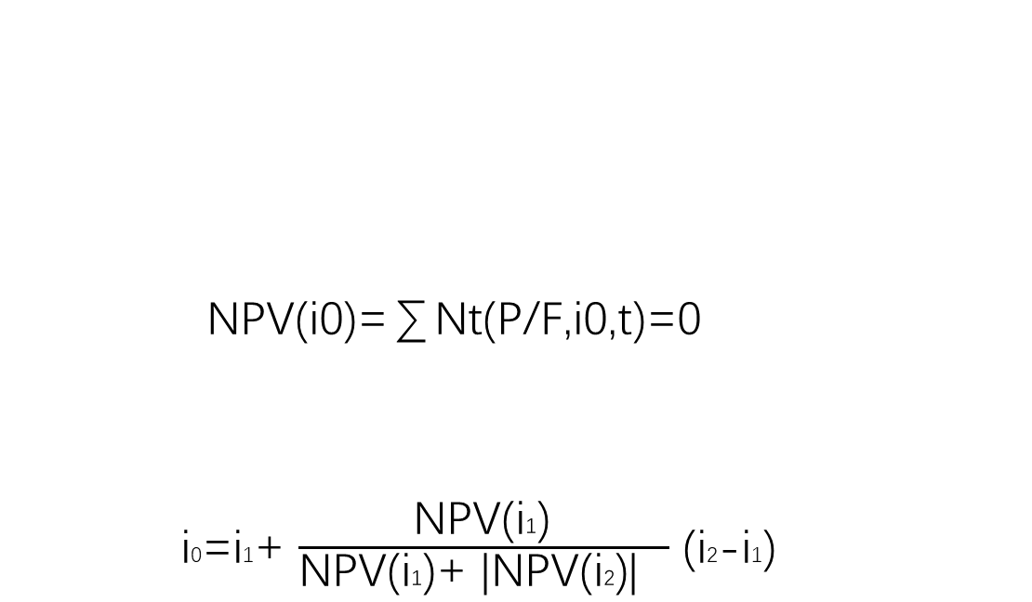
Quantitative Methods for Choosing Projects
Internal Rate of Return (IRR): The discount rate that makes the net present value of investment zero.
Calculators and computers perform by trial and error.
Potential for multiple IRR if cash flows vary
NPV(i0)=∑Nt(P/F,i0,t)=0
i0=i1+ $\frac{\text{NPV}\text{(}\text{i}\text{1}\text{)} }{\text{NPV}\text{(}\text{i}\text{1}\text{)+ }\text{|}\text{NPV}\text{(}\text{i}\text{2}\text{)}\text{|} }$ (i2-i1)
Notes:
16

Slide 17
NPV
NPV(i1)
0
i1
i0
i2
i(%)
NPV(i2)

Slide 18
Quantitative Methods for Choosing Projects
Strengths and Weaknesses of DCF Methods:
Strengths
Provide concrete financial estimates
Explicitly consider timing of investment and time value of money
Weaknesses
May be deceptive; only as accurate as original estimates of cash flows.
May fail to capture strategic importance of project
Notes:
18

Slide 19
Quantitative Methods for Choosing Projects
Real Options: Applies stock option model to nonfinancial resource investments. E.g.,with respect to R&D:
The cost of the R&D program can be considered the price of a call option.
The cost of future investment required to capitalize on the R&D program (such as the cost of commercializing a new technology that is developed) can be considered the exercise price.
The returns to the R&D investment are analogous to the value of a stock purchased with a call option.
Notes:
19

Slide 20
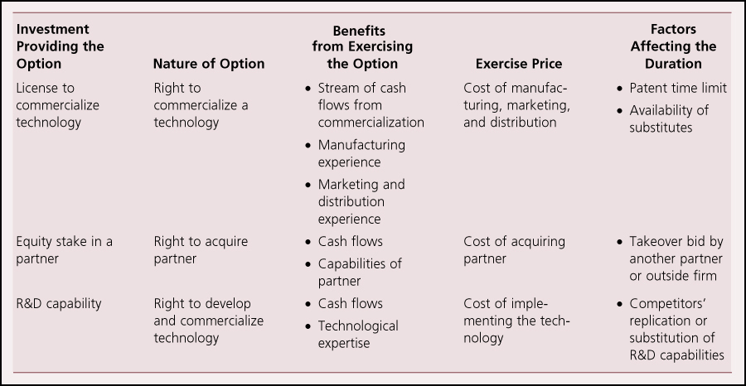
Quantitative Methods for Choosing Projects
Examples of real call options
Notes:
20

Slide 21
Quantitative Methods for Choosing Projects
Options are valuable when there is uncertainty (as in innovation)
However, real options models have some limitations:
Many innovation projects do not conform to the same capital market assumptions underlying option models.
May not be able to acquire option at small price: may require full investment before its known whether technology will be successful.
Value of stock option is independent of call holder’s behavior, but value of R&D investment is shaped by the firm’s capabilities, complementary assets, and strategies.
Notes:
21

Slide 22
Qualitative Methods of Choosing Projects
Many factors in the choice of development projects are extremely difficult (or misleading) to quantify.
Almost all firms thus use some qualitative methods.
Screening Questions may be used to assess different dimensions of the project decision including:
Role of customer (market, use, compatibility and ease of use, distribution and pricing)
Role of capabilities (existing capabilities, competitors’ capabilities, future capabilities)
Project timing and cost
Notes:
22

Slide 23
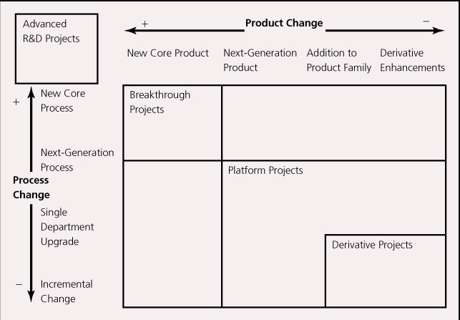
Qualitative Methods of Choosing Projects
The Aggregate Project Planning Framework
Managers map their R&D projects according to levels of risk, resource commitment and timing of cash flows
Notes:
23

Slide 24
Qualitative Methods of Choosing Projects
Advanced R&D Projects: develop cutting-edge technologies; often no immediate commercial application.
Breakthrough Projects: incorporate revolutionary new technologies into a commercial application.
Platform Projects: not revolutionary, but offer fundamental improvements over preceding generations of products.
Derivative Projects: incremental improvements and variety in design features.
Derivative projects pay off the quickest, and help service the firm’s short-term cash flow needs. Advanced R&D projects take a long time to pay off (or may not pay off at all), but can position the firm to be a technological leader.
Notes:
24

Slide 25
Qualitative Methods of Choosing Projects
Q-Sort is a simple method for ranking ideas on different dimensions.
Ideas are put on cards.
For each dimension being considered, the cards are stacked in order of their performance on that dimension.
Several rounds of sorting and debate are used to achieve consensus about the projects.
Notes:
25

Slide 26
Combining Quantitative and Qualitative Information
Managers may use multiple methods in combination.
May also use methods that convert qualitative information into quantitative form (though this has similar risks as discussed with quantitative methods)
Conjoint Analysis estimates the relative value individuals place on attributes of a choice.
Individuals given a card with products (or projects) with different features and prices.
Individuals rate each in terms of desirability or rank them.
Multiple regression then used to assess the degree to which an attribute influences rating. These weights quantify the trade-offs involved in providing different features.
Notes:
26

Slide 27
【Example】 We illustrate the conjoint methodology by considering the problem of how student evaluate sneakers. Qualitative research identified three attributes as salient: the sole, the upper, and the price. Each was defined in terms of three levels, as shown in Table 7.1. ( Resource: Naresh K. Malhotra, Marketing Research: an applied orientation, PRENTICE HALL, 1993)
Answer:
Step1. Evaluate sneaker profiles using a nine-point Likert scale (1=not preferred, 9=great preferred). Ratings obtained from one respondent are shown in Table 7.2.
Note: In this example, it was given three attributes, defined at three levels each, a total of 3×3×3=27 profiles can be constructed. To reduce the respondent evaluation, orthogonal arrays were employed and a set of nine profiles was constructed.

Slide 28
TABLE 7.1 Sneaker Attributes and
Levels
Attribute | LEVEL
 | No. | Description
Sole | 3 | Rubber
 | 2 | Polyurethane
 | 1 | Plastic
Upper | 3 | Leather
 | 2 | Canvas
 | 1 | Nylon
Price | 3 | $15.00
 | 2 | $30.00
 | 1 | $45.00

Slide 29
TABLE 7.2 Sneaker Profiles and Their Ratings
ATTRIBUTE LEVELS
Profile No. | Sole | Upper | Price | Preference Rating
1 | 1 | 1 | 1 | 9
2 | 1 | 2 | 2 | 7
3 | 1 | 3 | 3 | 5
4 | 2 | 1 | 2 | 6
5 | 2 | 2 | 3 | 5
6 | 2 | 3 | 1 | 6
7 | 3 | 1 | 3 | 5
8 | 3 | 2 | 1 | 7
9 | 3 | 3 | 2 | 6

Slide 30
Step 2. Calculate the utility functions for each attribute, as well as the relative importance of the attributes, and shown in Table 7.3.
TABLE 7.3 Results of Conjoint Analysis
Attribute | LEVEL |  | Utility | Relative Importance
 | No. | Description
Sole | 3 | Rubber | 0.778 | 0.286
 | 2 | Polyurethane | -0.556
 | 1 | Plastic | -0.222
Upper | 3 | Leather | 0.445 | 0.214
 | 2 | Canvas | 0.111
 | 1 | Nylon | -0.556
Price | 3 | $15.00 | 1.111 | 0.500
 | 2 | $30.00 | 0.111
 | 1 | $45.00 | -1.222

Slide 31
Interpreting the Results:
In terms of relative importance of the attributes, we see that the Price is number one. Second most important is Sole, followed closely by Upper. Since price is by far the most important attribute for this respondent, this person could be labeled as price sensitive.

Slide 32
Theory In Action
Courtyard by Marriot
Marriot used conjoint analysis to help it develop a midprice hotel line.
First used focus groups to identify customer segments and attributes they cared about in a hotel.
Then created potential hotel profiles that varied on these features and asked participants to rate the profiles.
Regression identified which features were valued most.
Based on the results, Marriott developed Courtyard concept: relatively small hotels with limited amenities, small restaurants and meeting rooms, courtyards, high security, and rates of $40-$60 a night.
Notes:
32

Slide 33
Combining Quantitative and Qualitative Information
Data Envelopment Analysis (DEA) uses linear programming to combine measures of projects based on different units (e.g., rank vs. dollars) into an efficiency frontier.
Projects can be ranked by assessing their distance from efficiency frontier.
As with other quantitative methods, DEA results only as good as the data utilized; managers must be careful in their choice of measures and their accuracy.
Notes:
33

Slide 34
[ Example ] The input and output of four branches of a bank are shown in the table below. Which branch has the best performance?
Branch
Input
Output
Number of
employees
Store area
savings
loan
Intermediate business
Branch 1
Branch2
Branch3
Branch4
15
20
21
20
140
130
120
135
1800
1000
800
900
200
350
450
420
1600
1000
1300
1500

Slide 35
Answer：
The DEA linear programming model for the efficiency evaluation of
branch 1 is written as follows:
min E
1800λ₁ +1000λ₂ + 800λ₃ + 900λ₄ ≥1000
200λ₁ + 350λ₂ + 450λ₃ + 420λ₄ ≥ 350
1600λ₁ +1000λ₂ +1300λ₃ +1500λ₄ ≥1000
S.t. 15λ₁ + 20λ₂ + 21λ₃ + 20λ₄ ≤ 15E
140λ₁ + 130λ₂ + 120λ₃ + 135λ₄ ≤140E
E, λ_{j} ≥0 （ j = 1，2，3，4 ）
Using LINGO to solve the above model, E = 1 is obtained，so the DEA analysis identified branch 1 as being relatively efficient.

Slide 36
Similarly，the DEA linear programming model for the efficiency evaluation of branch 2 is written as follows:
min E
1800λ₁ +1000λ₂ + 800λ₃ + 900λ₄ ≥1800
200λ₁ + 350λ₂ + 450λ₃ + 420λ₄ ≥ 200
1600λ₁ +1000λ₂ +1300λ₃ +1500λ₄ ≥1600
S.t. 15λ₁ + 20λ₂ + 21λ₃ + 20λ₄ ≤ 20E
140λ₁ + 130λ₂ + 120λ₃ + 135λ₄ ≤130E
E, λ_{j} ≥0 （ j = 1，2，3，4 ）
Using LINGO to solve the above model, E = 0.996 is obtained，so the DEA analysis identified branch 2 as being relatively inefficient.

Slide 37
For branch 3, E = 1 is obtained，so the DEA analysis identified branch 3 as being relatively efficient.
For branch 4, E = 1 is obtained，so the DEA analysis identified branch 4 as being relatively efficient.

Slide 38
Discussion Questions
1. What are the advantages and disadvantages of discounted cash flow methods such as NPV and IRR?
2. For what kind of development projects might a real options approach be appropriate? For what kind of projects would it be inappropriate?
3. What are some of the reasons that a firm might use both qualitative and quantitative assessments of a project?
4. Identify a particular development project you are familiar with. What kinds of methods do you believe were used to assess the project? What kinds of methods do you believe should have been used to assess the project?
5. Will different methods of evaluating a project typically yield the same conclusions about whether to fund its development? Why or why not?
Notes:
38

